Slide 1

Paper Topic Classification
with Active Learning
Daehyun Cho
Cognitive System Lab
A.I. Dept, Korea Univ.
2021-12-01
1

Slide 2

Index
1
Proposed Ideas & Methods
2
Results
3
Discussions & Conclusion
+
Backups including detailed setup
Cogsys Lab

Slide 3
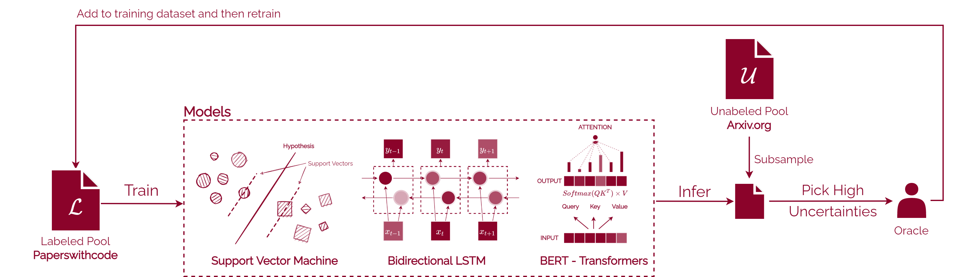
Whole Pipeline Blueprint
※ Some conditions may change during the project
1
Proposed Ideas & Methods
Cogsys Lab, Daehyun Cho

Slide 4
Multi-label Classification Problem with Paper Title+Abstract
Data
paperswithcode: contains 12k papers from A.I. Field
arxiv: contains 1.7M papers from many fields – will use A.I. related only
Task
A.I. Field Multi-label Classification
Active Learning with Labeled Pool (paperswithcode) and Unlabeled Pool (arxiv)
Details
Uncertainty-based sampling methods
Classic Active Learning / BALD / BatchBALD
Uncertainty-estimation methods
Monte Carlo Dropout / Full Ensemble
and compare with Naïve Training with 100% of the data
with/without abstract (long text)
1
Proposed Ideas & Methods
Cogsys Lab, Daehyun Cho

Slide 5
Multi-label Classification Problem with Paper Title+Abstract
Data
paperswithcode: contains 50k papers from A.I. Field
arxiv: contains 1.7M papers from many fields – will use A.I. related only
Task
A.I. Field Multi-label Classification
Active Learning with Labeled Pool (paperswithcode) and Unlabeled Pool (arxiv)
Details
Uncertainty-based sampling methods
Random / Least Confidence / Margin of Confidence / BALD / BatchBALD
Uncertainty-estimation methods
Monte Carlo Dropout / Full Ensemble (Due to HW limits)
and compare with Naïve Training with 100% of the data + 1%, 5%, 10%, 20%, 50%
with/without abstract (long text) (Again, HW limits)
1
Proposed Ideas & Methods
Cogsys Lab, Daehyun Cho

Slide 6
Research Questions
Implementing Active Learning from scratch
How much initial data should be given?
Do deep learning models should be totally “retrained” every after acquisition?
For pretrained models, it’s okay to start back from the acquisition, but what about others?
Experiments
To discover above questions, I setup the experiments with some models and varying configurations.
Models with their parameters about the similar scale (20~30M)
Bidirectional-LSTM 2-layer, bidirectional.
1dCNN-LSTM 4-layer with varying kernel size.
BERT 4-layer, FF 768-dim, no pretrained models.
Embedding matrix (vocab_size, embed_size) = (83931, 256) ~ 21M
*Detailed methods will be discussed later, if you have any questions.
1
Research Question
Cogsys Lab, Daehyun Cho

Slide 7
Pipeline
Make baseline results with varying portion of data
Find the optimal model configuration.
Run with varying configurations below.
Acquiring amount : 1%, 5% of total
Acquisition method : Random, LC, Margin, BALD, BatchBALD
Retraining : True or False. When True, acquire when model saturates, otherwise with fixed steps.
Models : BiLSTM, 1dCNN, BERT
1
Pipeline
Cogsys Lab, Daehyun Cho

Slide 8
Notice
To fit the presentation in time, I omit the followings and will be explained in backup
Detailed model setups
BERT Results
BatchBALD
Cogsys Lab, Daehyun Cho

Slide 9
Setting Model Size & Initial Data Point
Tried with base/large configuration.
Experiment with different initial data point
1
Pipelines
Configuration | size | 1dCNN | BiLSTM | BERT
# embed size | Base | 256
 | Large | 512
# layers | Base | 4 | 4 | 4
 | Large | 4 | 4 | 6
# intermediate size (channel) | Base | 256 | 256 | 256
# params | Large | 1,024 | 512 | 768
# params | Base | 25M~
 | large | 65M~
[Table 1] Model Configuration.
Cogsys Lab, Daehyun Cho

Slide 10
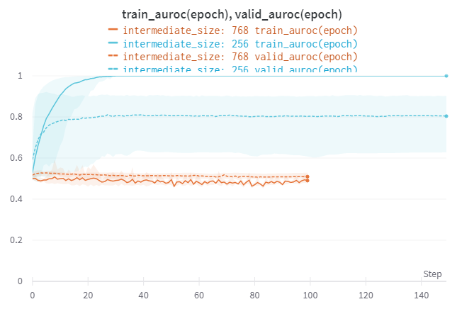
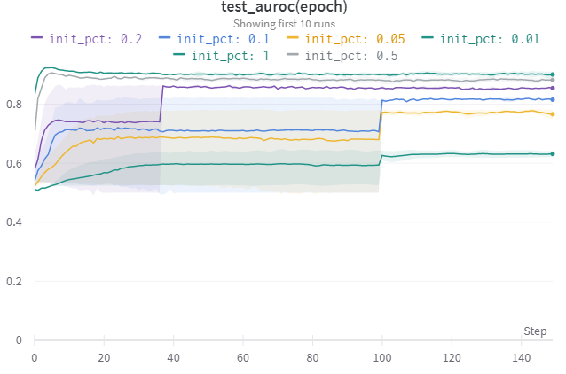
Setting Model Size & Initial Data Point
Large models can’t converge. Used Base Model
Initial percentage of 20% was selected.
2
Baseline Results
[Fig 1a] Large vs. Base Model AUROC
[Fig 1b] Initial data point, test AUROC
Cogsys Lab, Daehyun Cho

Slide 11
Naïve Training Baseline Results
BiLSTM 0.8467 | 1dCNN 0.849 | BERT 0.7613
2
Baseline Results
Testing
Tried with base/large configuration.
Experiment with different initial data point
Question | Variation
Let’s do Active Learning | Random vs. LC, Margin, BALD
How acquisition period matters? | 5, 10 epoch
How much to acquire | 1%/5% of total (becomes 500/1,500 per acquisition)
Re-train vs. Keep-train | Compare final test AUROC Re-train and Keep-Train
In overall, did active learning help training?
[Table 2] Experiment Configuration
Cogsys Lab, Daehyun Cho

Slide 12
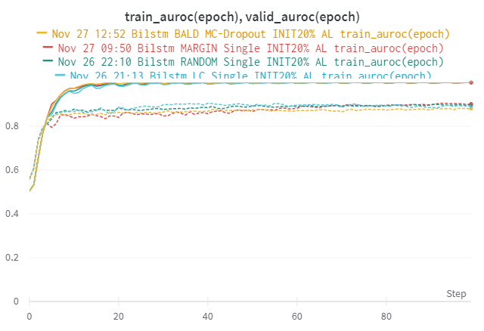
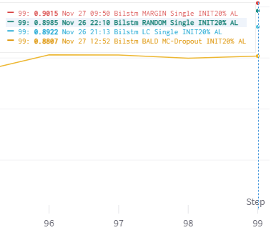
Compare Different Uncertainty Selection. (BiLSTM)
LC, BALD did not surpass Random, but the difference is not significant.
Naïve training setup with 50/100% of the data, 90.32/88.01% AUROC.
2
Results
BiLSTM 0.8467
[Fig 2a] Random, LC, Margin, BALD of BiLSTM(base)
Cogsys Lab, Daehyun Cho

Slide 13
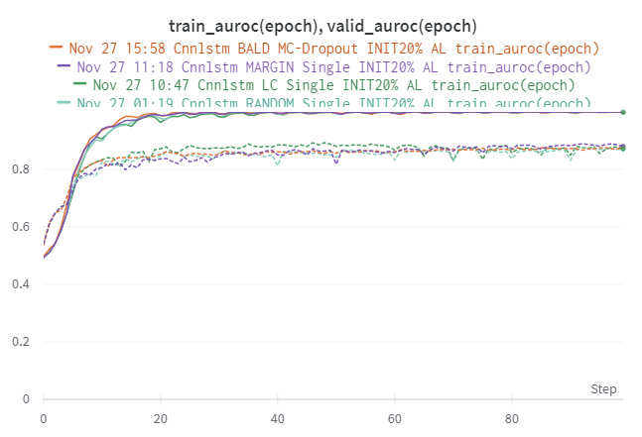
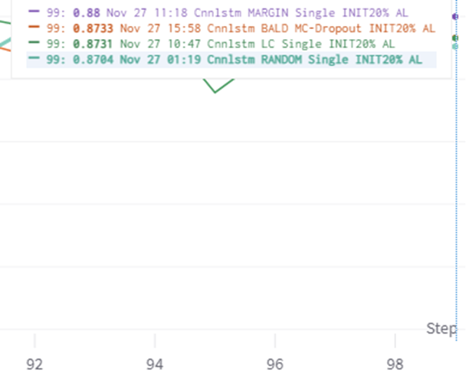
Compare Different Uncertainty Selection. (1dCNN)
All methods surpass the random, but only margin looks superior to random in 1%p enhancement.
Since with 50% of the total data in naïve training got 87.57% AUROC at last, there was a slight improvement
2
Results
1dCNN 0.849
[Fig 2b] Random, LC, Margin, BALD of 1dCNN(base)
Cogsys Lab, Daehyun Cho

Slide 14
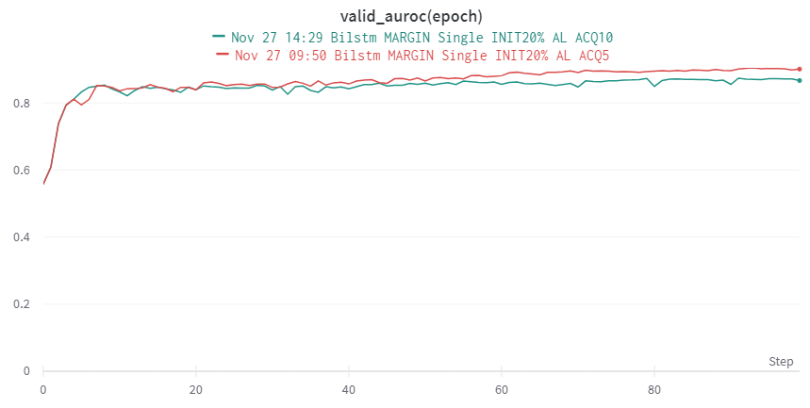
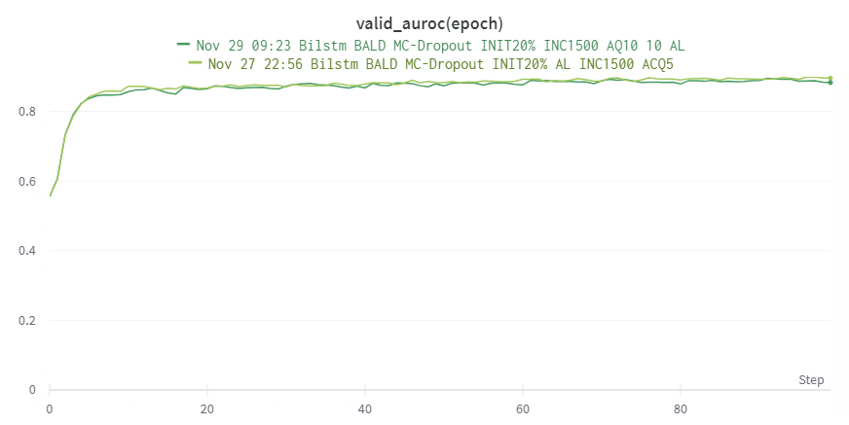

Acquisition Period
Doesn’t have significant difference in BALD
Margin showed a slight improvement
2
Results
[Fig 3a] Acquisition Period 5/10 with BiLSTM Margin
[Fig 3b] Acquisition Period 5/10 with BiLSTM BALD
Cogsys Lab, Daehyun Cho

Slide 15
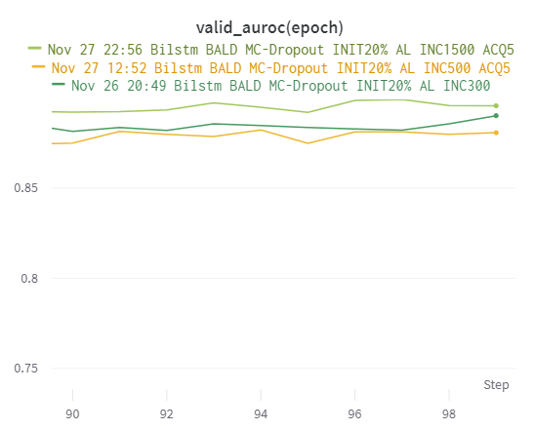

Compare Increment Amount (BALD, BiLSTM) – 300, 500, 1500
As expected, more data leads to better performance. (300 vs. 1500 with ~1.5%p improvement)
2
Results
[Fig 4] Increment amount comparison with BiLSTM BALD
Cogsys Lab, Daehyun Cho

Slide 16
Re-train vs. Keep-train
Machine learning methods, with the rise of computing power, mostly takes a few seconds to fit to the given training data at least in 50k~100k rows of data.
Deep learning methods still needs lots of epochs for model to get trained, and time consuming.
In context of active learning, deep learning models get re-trained (re-instantiate and then train) in general even with this exhaustive setup, at least in the project I have seen.
In came to my attention that re-training didn’t seem to be efficient, so I compared two configurations.
For re-training, 1 epoch – 1 acquisition strategy was not plausible for me.
Therefore, I tried 20 epoch – 1 acquisition strategy to fit the model.
2
Results
Cogsys Lab, Daehyun Cho

Slide 17
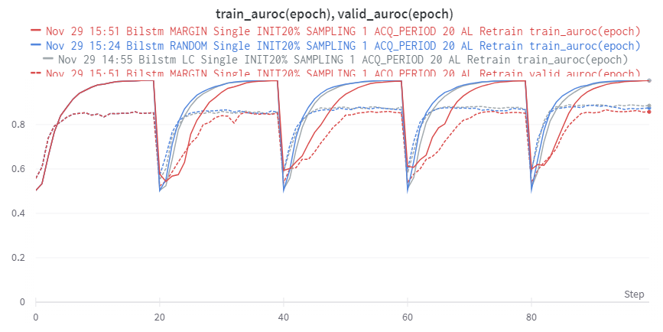
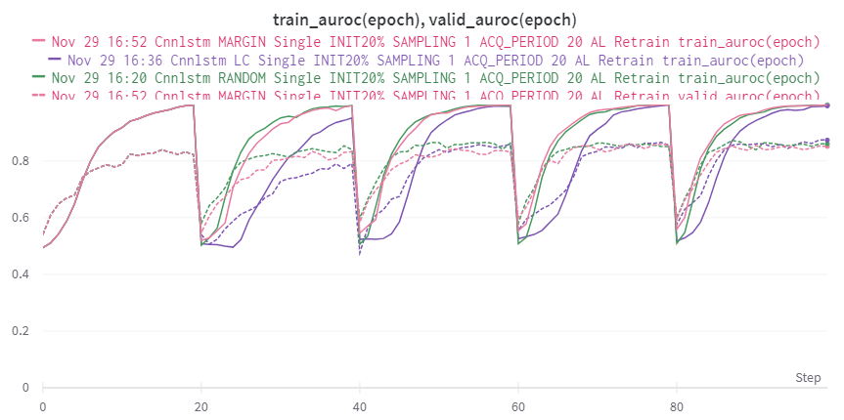
Re-train vs. Keep-train
2
Results
[Fig 4a] Retrain with 4 acquisition methods - BiLSTM
[Fig 4b] Retrain with 4 acquisition methods – 1dCNN
Cogsys Lab, Daehyun Cho

Slide 18
Re-train vs. Keep-train
LC showed the best performance at last in both models
Fluctuations
2
Results
Model | Method | Valid AUROC step before Acquisition+Retrain
 |  | 20 | 40 | 60 | 80 | 100
BiLSTM | Random | .8529 | .8559 (+.0030) | .8628 (+.0069) | .8667 (+.0039) | .8747 (+.0120)
 | LC |  | .8567 (+.0038) | .8797 (+.0023) | .8674 (+.0123) | .8853 (+.0179)
 | Margin |  | .8524 (-.0005) | .8542 (+.0018) | .8511 (-.0031) | .8573 (+.0062)
1dCNN | Random | .8221 | .8404 (+.0183) | .8628 (+.0194) | .8509 (-.0119) | .8608 (+.0099)
 | LC |  | .791 (-.0311) | .8579 (+.0669) | .8557 (-.0022) | .8734 (+.0177)
 | Margin |  | .8327 (+.0106) | .8317 (-.00 10) | .8572 (+.0255) | .8513 (-.0059)
[Table 3] Random, LC, Margin / BiLSTM, 1dCNN retrain result organized.
Cogsys Lab, Daehyun Cho

Slide 19
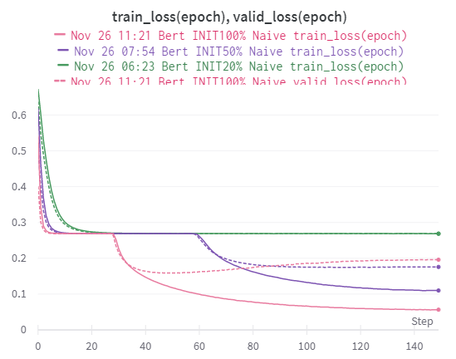
Transformers.
Unlike recurrent neural networks, transformer networks is hard to get trained in this dataset.
Reason is that
Not pretrained
Shallow network with attention
Even the naïve training takes much time to get stabilized.
2
Results
[Fig 5a] BERT Naïve Training
Cogsys Lab, Daehyun Cho

Slide 20
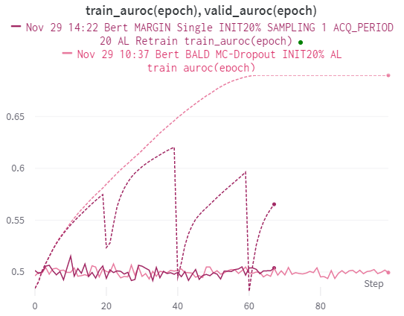
Transformers.
Tried many different methods… but did not give any insights.
2
Results
[Fig 5b] Active Learning with BERT
Cogsys Lab, Daehyun Cho

Slide 21
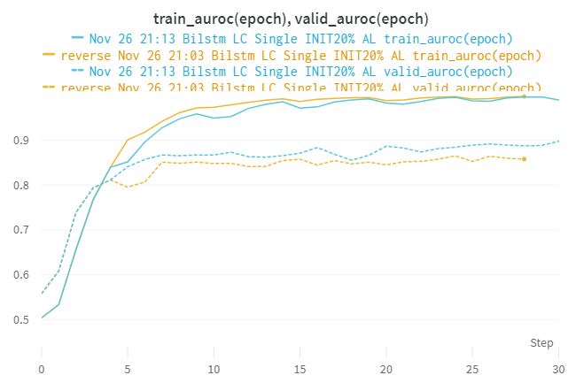
Unintended Ablation Study.
We should use high uncertainty samples for acquisition
I accidentally sorted these samples in a reverse way, so that the samples with lowest uncertainty were chosen
Even though I find active learning hard to apply in useful way, in this point of view active learning is working
*I know that we need extra runs for validity.
2
Interesting Findings
[Fig 6] LC with the most and the least - BiLSTM
Cogsys Lab, Daehyun Cho

Slide 22
Overall, Did Active Learning helped?
Some result gives higher performance than random but not dramatically high as in related works.
Also some results shows similar/higher performance with the result of more data.
Similar performance in the full naïve training setup, we can see that active learning not only works in typical toy data but in real data as well.
Might be better if …
Hardware limits
Train with abstract
Pretrained-transformer models.
Full-ensemble models
Extra seeds per trial
Plot Uncertainty distribution.
3
Discussion &
Conclusion
Cogsys Lab, Daehyun Cho

Slide 23
About Active Learning
https://minds.wisconsin.edu/bitstream/handle/1793/60660/TR1648.pdf?sequence=1
https://dsgissin.github.io/DiscriminativeActiveLearning/2018/07/05/AL-Intro.html
https://jacobgil.github.io/deeplearning/activelearning
Discriminative Active Learning
https://arxiv.org/pdf/1907.06347.pdf
https://dsgissin.github.io/DiscriminativeActiveLearning/2018/07/05/DAL.html
https://github.com/dsgissin/DiscriminativeActiveLearning
https://kmhana.tistory.com/12?category=838050
BALD
https://arxiv.org/pdf/1112.5745.pdf
https://arxiv.org/pdf/1703.02910.pdf
https://github.com/Riashat/Deep-Bayesian-Active-Learning
BatchBALD
https://arxiv.org/abs/1906.08158
https://oatml.cs.ox.ac.uk/blog/2019/06/24/batchbald.html
https://github.com/BlackHC/BatchBALD
+
References
Cogsys Lab, Daehyun Cho

Slide 24
Thank you 🙏
Questions ?
All works+references+detailed experiment resides here.
https://github.com/1pha/BayesianActiveLearning
https://wandb.ai/1pha/Active-Learning
Daehyun Cho
Cogsys Lab, AI Dept
1phantasmas@korea.ac.kr
Cogsys Lab

Slide 25
+
Backups & Methods
__unused slides
Cogsys Lab

Slide 26
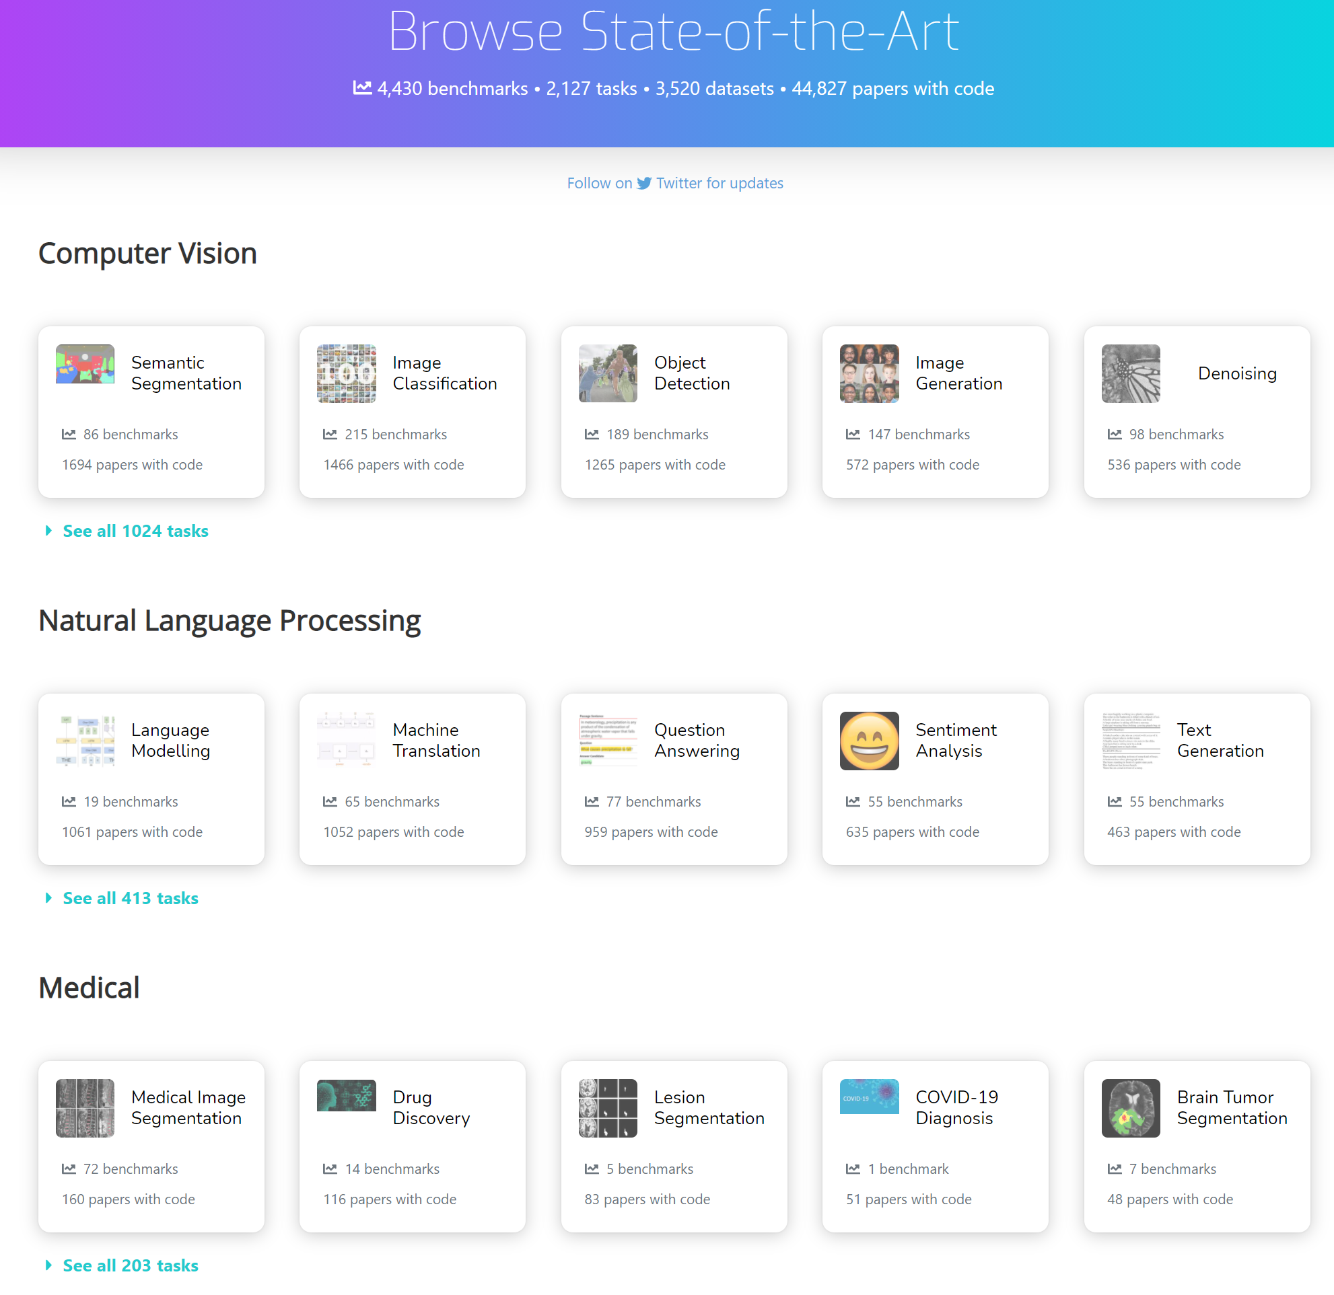
Multi-label Classification Problem with Paper Title+Abstract
paperswithcode contains 12k papers from A.I. Field
Contains “specific” A.I. Field
Some belongs to multiple areas.
Train/Valid/Test splits with 90/5/5
arxiv contains 1.7M papers from many fields
Does not contain A.I. Field
I will use this as unlabeled pool
which means … I, oracle, has to do some labe-our
1
Data Distribution and Description
area
Cogsys Lab, Daehyun Cho

Slide 27
Multi-label Classification Problem with Paper Title+Abstract
paperswithcode contains 12k papers from A.I. Field
Contains “specific” A.I. Field
Some belongs to multiple areas.
Train/Valid/Test splits with 90/5/5
arxiv contains 1.7M papers from many fields
Does not contain A.I. Field
I will use this as unlabeled pool
which means … I, oracle, has to do some labe-our
1
Pipeline
area
Cogsys Lab, Daehyun Cho

Slide 28
+
Alumni
__slides from Interim Presentation
Cogsys Lab

Slide 29
Multi-label Classification Problem with Paper Title+Abstract
paperswithcode contains 12k papers from A.I. Field
Contains “specific” A.I. Field
Some belongs to multiple areas.
Train/Valid/Test splits with 90/5/5
arxiv contains 1.7M papers from many fields
Does not contain A.I. Field
I will use this as unlabeled pool
which means … I, oracle, has to do some labe-our
1
Project Plan
area
Cogsys Lab, Daehyun Cho

Slide 30
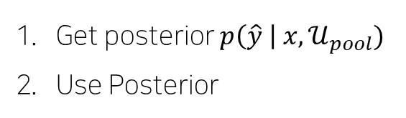
Whole Pipeline in Blueprint
3
Related Works
Get posterior $p\left(\hat{y} \right| x, 𝒰_{pool})$
Use Posterior
Cogsys Lab, Daehyun Cho

Slide 31
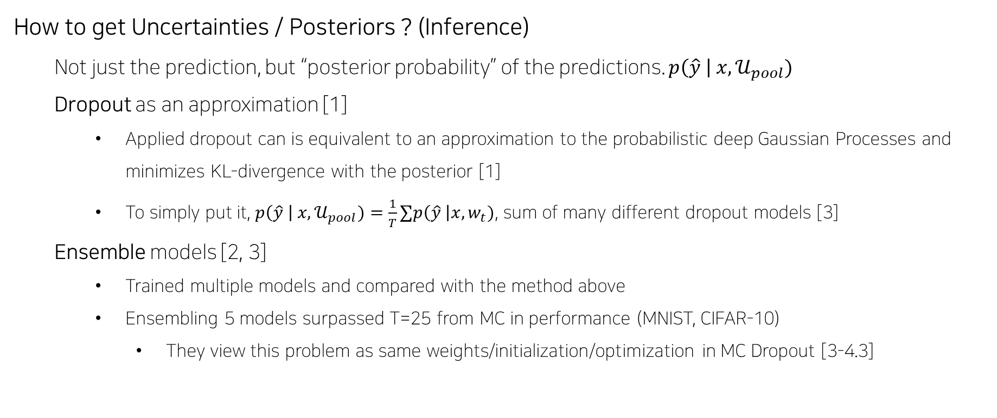
How to get Uncertainties / Posteriors ? (Inference)
Not just the prediction, but “posterior probability” of the predictions. $p\left(\hat{y} \right| x, 𝒰_{pool})$
Dropout as an approximation [1]
Applied dropout can is equivalent to an approximation to the probabilistic deep Gaussian Processes and minimizes KL-divergence with the posterior [1]
To simply put it, $p\left(\hat{y} \right| x, 𝒰_{pool})=\frac{1}{T}∑p\left(\hat{y} \right|x, w_{t})$, sum of many different dropout models [3]
Ensemble models [2, 3]
Trained multiple models and compared with the method above
Ensembling 5 models surpassed T=25 from MC in performance (MNIST, CIFAR-10)
They view this problem as same weights/initialization/optimization in MC Dropout [3-4.3]
3
Related Works
[1] Gal, Yarin, and Zoubin Ghahramani. "Dropout as a bayesian approximation: Representing model uncertainty in deep learning." international conference on machine learning. PMLR, 2016.
[2] Lakshminarayanan, Balaji, Alexander Pritzel, and Charles Blundell. "Simple and scalable predictive uncertainty estimation using deep ensembles." arXiv preprint arXiv:1612.01474 (2016).
[3] Beluch, William H., et al. "The power of ensembles for active learning in image classification." Proceedings of the IEEE Conference on Computer Vision and Pattern Recognition. 2018.
Cogsys Lab, Daehyun Cho

Slide 32
+
How to alleviate Uncertainties ?: Classic Active Learning [4]
Uncertainty Sampling
Random Sampling
Least Confidence
Margin Sampling
Query-By-Committee (QBC)
Vote Entropy
KL-Divergence
Expected Model Change (EGL)
Vote Entropy
KL-Divergence
Variance Reduction and Fisher Information Ratio (FIR)
Related Works
[4] Settles, Burr. "Active learning literature survey." (2009).
Cogsys Lab, Daehyun Cho

Slide 33
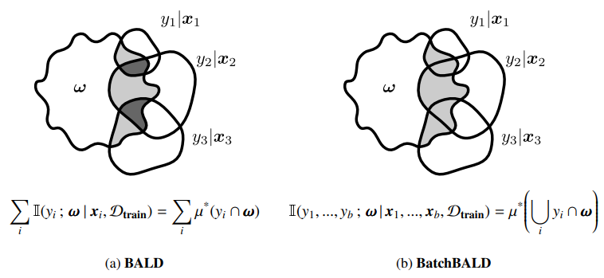
How to alleviate Uncertainties ? - for Deep Learning
Deep Learning has difficulties in - [5]
Requiring Large amounts of data
No representation about model uncertainty
Discriminative Active Learning (DAL) [6]
Select a sample that is far from learned representation
Bayesian Active Learning by Disagreement (BALD) [7]
Find examples whose output is marginally uncertain, with many disagreements between sampled models
BatchBALD [8]
Tackled problem of selecting “near” duplicates from BALD
3
Related Works
[5] Gal, Yarin, Riashat Islam, and Zoubin Ghahramani. "Deep bayesian active learning with image data." International Conference on Machine Learning. PMLR, 2017.
[6] Gissin, Daniel, and Shai Shalev-Shwartz. "Discriminative active learning." arXiv preprint arXiv:1907.06347 (2019).
[7] Houlsby, Neil, et al. "Bayesian active learning for classification and preference learning." arXiv preprint arXiv:1112.5745 (2011).
[8] Kirsch, Andreas, Joost Van Amersfoort, and Yarin Gal. "Batchbald: Efficient and diverse batch acquisition for deep bayesian active learning." Advances in neural information processing systems 32 (2019): 7026-7037.
Cogsys Lab, Daehyun Cho

Slide 34
Applications to Natural Language Processing tasks ?
1dCNN / LSTM / CRF + AL
LC / MNLP / BALD Sampling on NER – SOTA with much less data [9]
LC / Dropout+BALD / Backprop-by-Bayes on few tasks [10]
SC: no significance / NER, SRL: with 50% of the dataset, outperforms w/o AL
BERT + AL
BERT Finetune on Unlabeled Pool gives performs better than standard BERT Finetuning [11]
In real-world challenging scenario, AL can improve model performance [12]
BERT Classification task with AL performs well [13]
No single strategy outperforms the other [12, 13]
3
Related Works
[9] Shen, Yanyao, et al. "Deep active learning for named entity recognition." arXiv preprint arXiv:1707.05928 (2017).
[10] Siddhant, Aditya, and Zachary C. Lipton. "Deep bayesian active learning for natural language processing: Results of a large-scale empirical study." arXiv preprint arXiv:1808.05697 (2018).
[11] Margatina, Katerina, Loic Barrault, and Nikolaos Aletras. "Bayesian Active Learning with Pretrained Language Models." arXiv preprint arXiv:2104.08320 (2021).
[12] Dor, Liat Ein, et al. "Active learning for BERT: An empirical study." Proceedings of the 2020 Conference on Empirical Methods in Natural Language Processing (EMNLP). 2020.
[13] Prabhu, Sumanth, Moosa Mohamed, and Hemant Misra. "Multi-class Text Classification using BERT-based Active Learning." arXiv preprint arXiv:2104.14289 (2021).
Cogsys Lab, Daehyun Cho

Slide 35
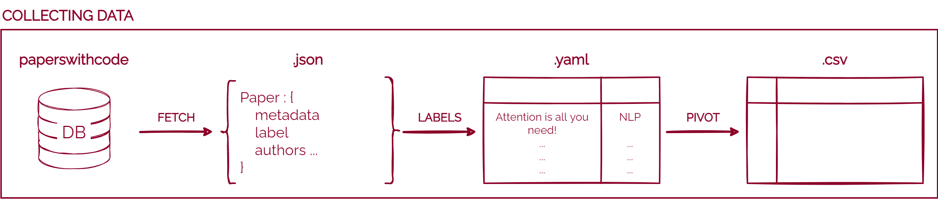
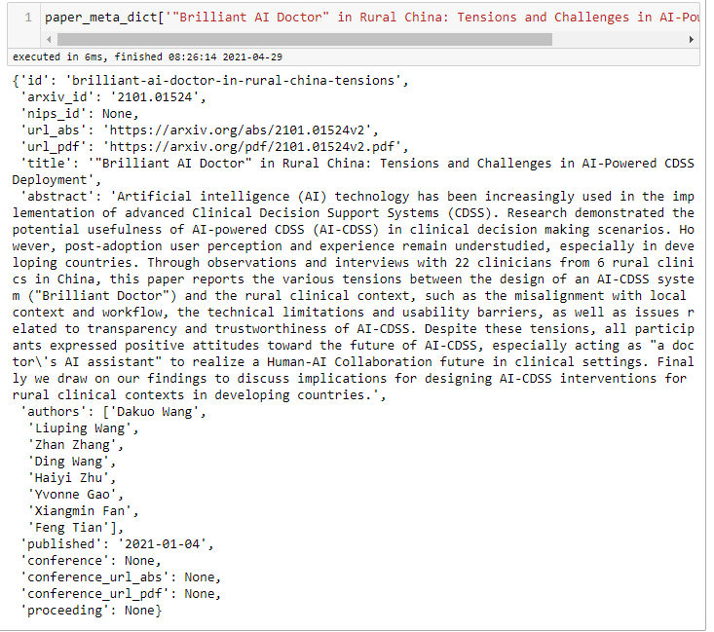
+
Paperswithtopic Data Collection Pipeline
Experiments
Use paperswithcode Database
Database page made with Django library with their domain open
Everyone can fetch data here!
There is an open API made by them, but does not work
I partially used their open-source code to scrape the data
Fetching and Organizing Data
Right figure is the raw meta-data fetched from the DB
Here I only used ‘title’ and ‘area’
‘area’ is not seen on the figure since papers were scraped by area
Fig. 1 Raw Meta Data for each paper
Cogsys Lab, Daehyun Cho

Slide 36
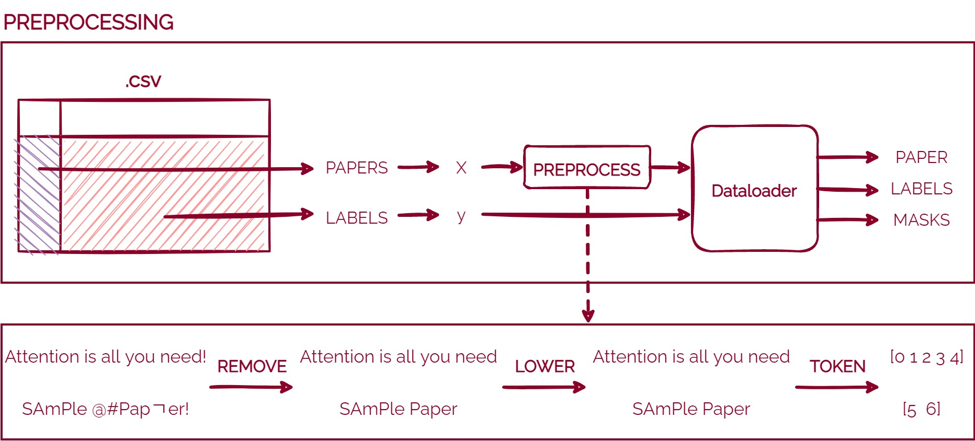
+
Preprocessing
Experiments
Make correct X, y
Preprocessing is the most important part in NLP
I only leaved Alphabets and Numbers
Chinese, Special characters were all removed
Lowered the alphabets
Tokenized by word
Embedding
This can be done with many ways, such as –
sentencepiece, word2vec, FastText
Possible to remove tenses (plural, past tense e.t.c)
Word embeddings
But we can also expect deep learning to do that as well.
Cogsys Lab, Daehyun Cho

Slide 37
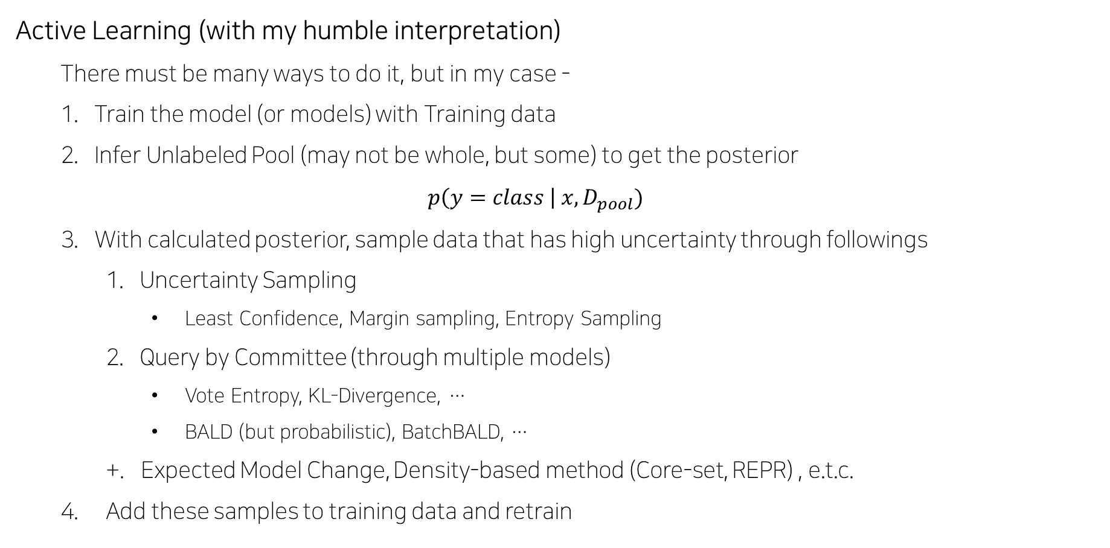
+
Active Learning (with my humble interpretation)
There must be many ways to do it, but in my case -
Train the model (or models) with Training data
Infer Unlabeled Pool (may not be whole, but some) to get the posterior $p\left(y=class \right| x, D_{pool})$
With calculated posterior, sample data that has high uncertainty through followings
Uncertainty Sampling
Least Confidence, Margin sampling, Entropy Sampling
Query by Committee (through multiple models)
Vote Entropy, KL-Divergence, …
BALD (but probabilistic), BatchBALD, …
+. Expected Model Change, Density-based method (Core-set, REPR) , e.t.c.
Add these samples to training data and retrain
Cogsys Lab, Daehyun Cho

Slide 38
Why this project?
Why Multi-label Classification?
It was interesting that AL can do the work with small portion of data in many classification tasks by finding decision boundaries with tactic.
Wondering if multi-label classification would work too.
Why NLP?
There were some works about NLP + AL in the field, but not deeply and especially Attention models were hard to find
Also, I have some side project on this and became curious about how AL would fit in.
Why SVM / BiLSTM / BERT ?
ML models screwed up in my previous projects and wanted to see if AL works for SVM.
BiLSTM was most widely used model in NLP+AL Related works
BERT easy to implement and definitely should be tell apart with Recurrent Models
Other transformer models in candidate as well
2
Motivation
Cogsys Lab, Daehyun Cho

Slide 39
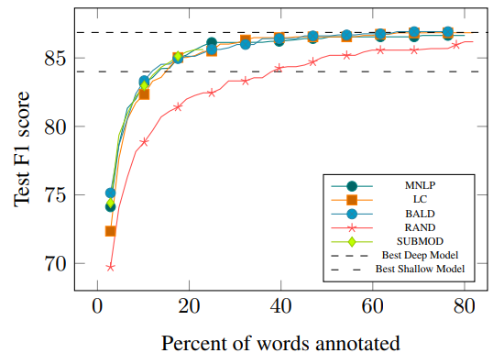
Deep active learning for named entity recognition [1]
One of early trials using Active learning in Deep learning models
Used MNLP/LC [2] sampling methods and BALD [3] and Random as baseline
This work came out before the boom of Transformers, 1dCNN and BiLSTM were used
Would be interesting to find more insight
tested on CoNLL-2003, OntoNotes-5.0 (2013)
Achieved SOTA trained with standard methods with much less data
3
Related Works
[1] Shen, Yanyao, et al. "Deep active learning for named entity recognition." arXiv preprint arXiv:1707.05928 (2017).
[2] Houlsby, Neil, et al. "Bayesian active learning for classification and preference learning." arXiv preprint arXiv:1112.5745 (2011).
[3] Settles, Burr. "Active learning literature survey." (2009).
Cogsys Lab, Daehyun Cho

Slide 40
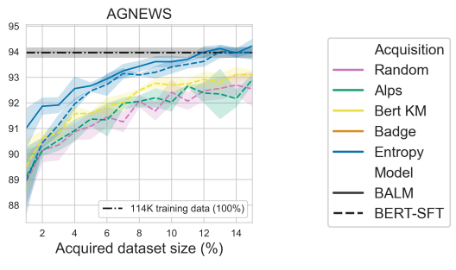
Bayesian Active Learning with Pretrained Language Models. [4]
Transformer architecture experiments with multiple AL strategy
Pretrained Models are Finetuned again in a specific task
In this finetuning stage, this work used active learning in order to achieve high performance with much less data
Compared with standard finetuning methods with multiple datasets
Within 15% of all datasets, active learning strategy surpassed the standard training options.
No acquisition strategy universally performs better
3
Related Works
[4] Margatina, Katerina, Loic Barrault, and Nikolaos Aletras. "Bayesian Active Learning with Pretrained Language Models." arXiv preprint arXiv:2104.08320 (2021).
Cogsys Lab, Daehyun Cho

Slide 41
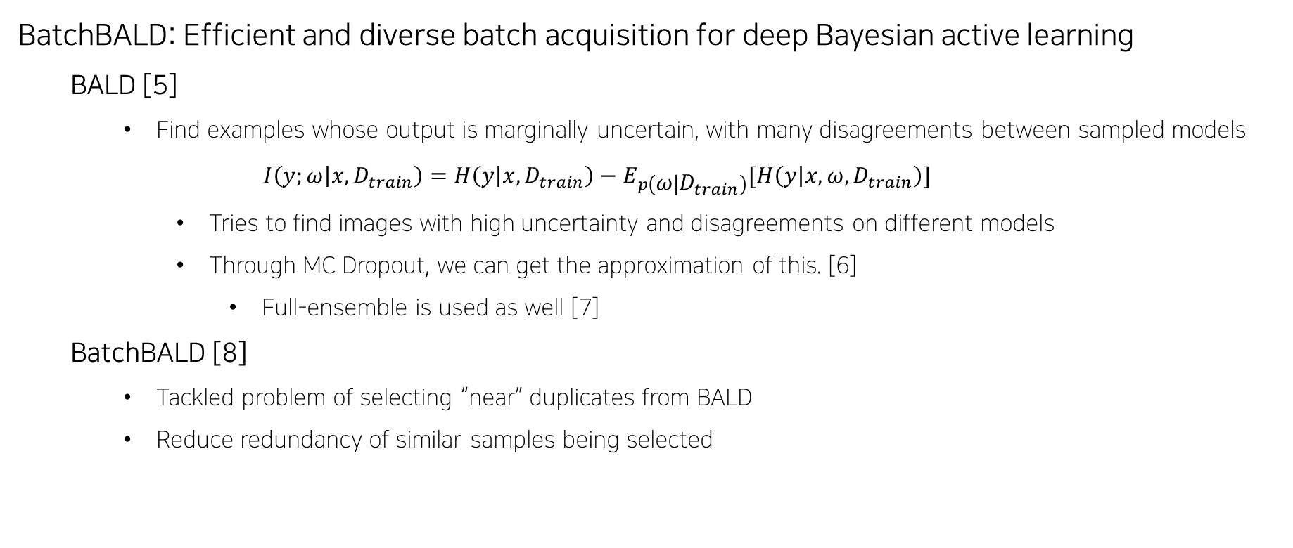
BatchBALD: Efficient and diverse batch acquisition for deep Bayesian active learning
BALD [5]
Find examples whose output is marginally uncertain, with many disagreements between sampled models
$$I\left(y;ω | x, D_{train}\right)=H\left(y | x, D_{train}\right)−E_{p\left(ω | D_{train}\right)}[H\left(y | x, ω, D_{train}\right)]$$
Tries to find images with high uncertainty and disagreements on different models
Through MC Dropout, we can get the approximation of this. [6]
Full-ensemble is used as well [7]
BatchBALD [8]
Tackled problem of selecting “near” duplicates from BALD
Reduce redundancy of similar samples being selected
3
[5] Houlsby, Neil, et al. "Bayesian active learning for classification and preference learning." arXiv preprint arXiv:1112.5745 (2011).
[6] Gal, Yarin, and Zoubin Ghahramani. "Dropout as a bayesian approximation: Representing model uncertainty in deep learning." international conference on machine learning. PMLR, 2016.
[7] Kirsch, Andreas, Joost Van Amersfoort, and Yarin Gal. "Batchbald: Efficient and diverse batch acquisition for deep bayesian active learning." Advances in neural information processing systems 32 (2019): 7026-7037.
[8] Beluch, William H., et al. "The power of ensembles for active learning in image classification." Proceedings of the IEEE Conference on Computer Vision and Pattern Recognition. 2018.
Cogsys Lab, Daehyun Cho

Slide 42
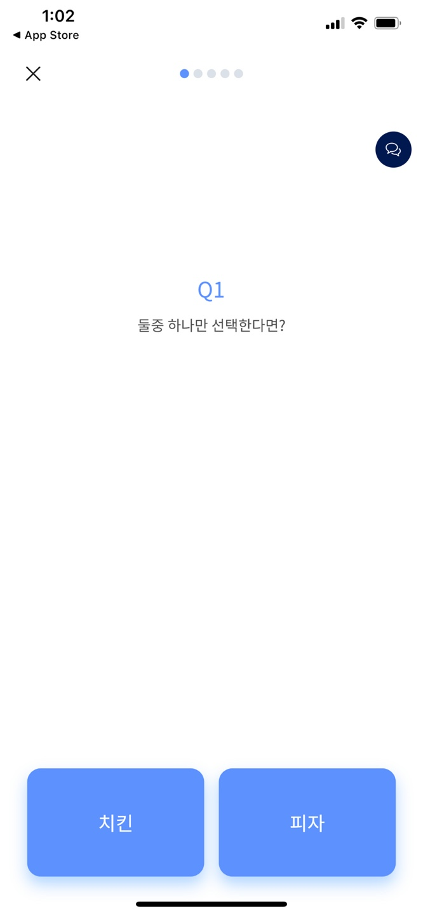
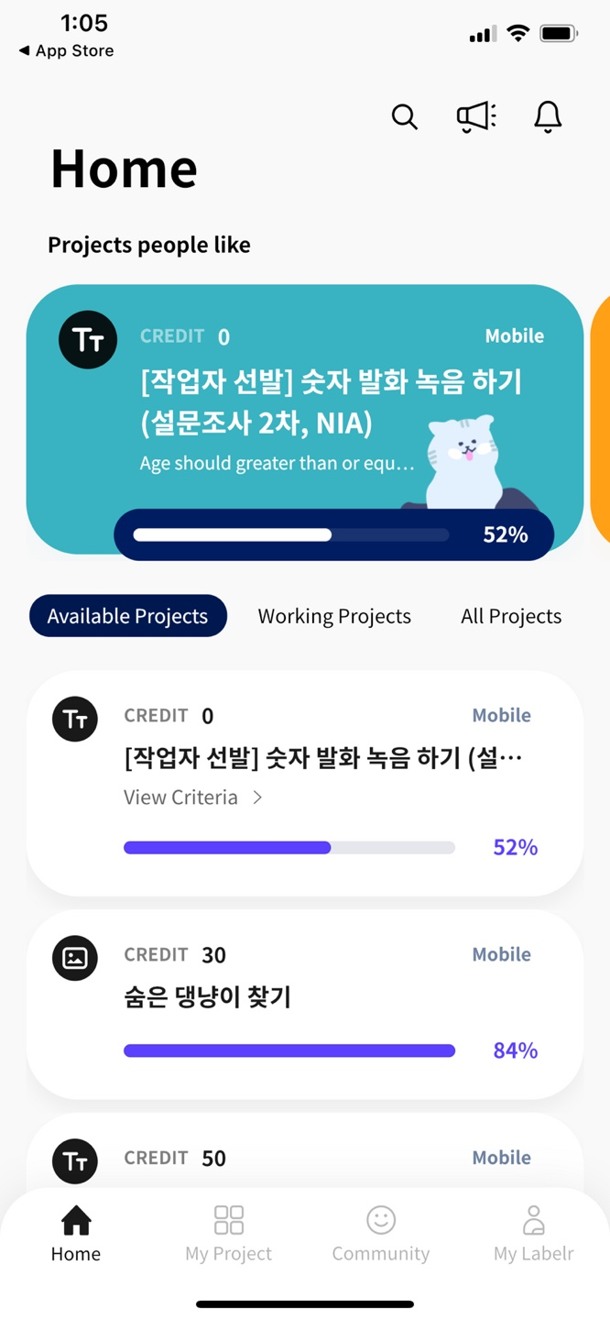
Through this project …
Similar/Same approach to novel dataset
More insight about NLP + AL
Trials with various ML/Transformer models
Domain-specific dataset
Serving (if possible)
Thinking of data annotation tool
Annotating “high uncertainty” data first would help in large amounts of data
Not going to deploy seriously, but just a mockup
4
Contributions
Cogsys Lab, Daehyun Cho

